Slide 1
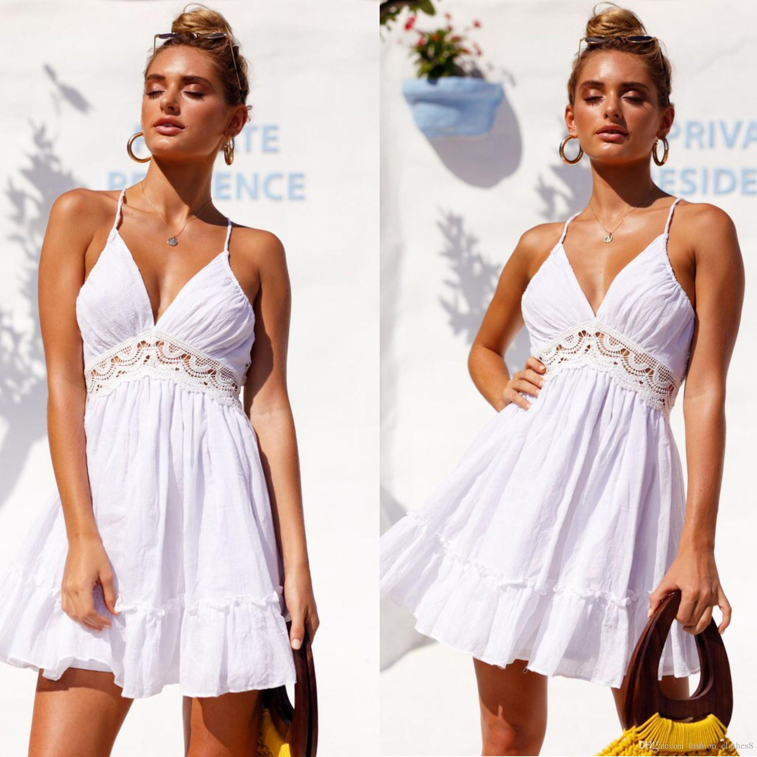

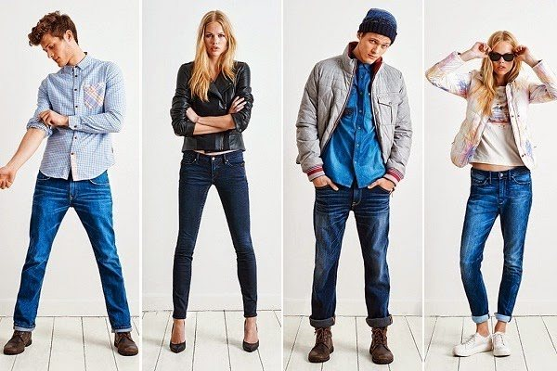
PHENS & CO. Sales Conversion Optimization Project

Slide 2
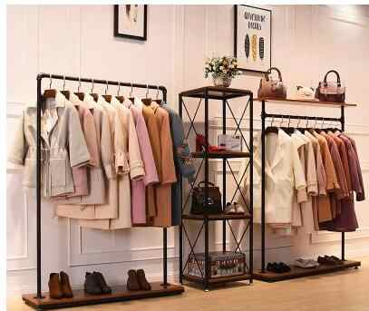
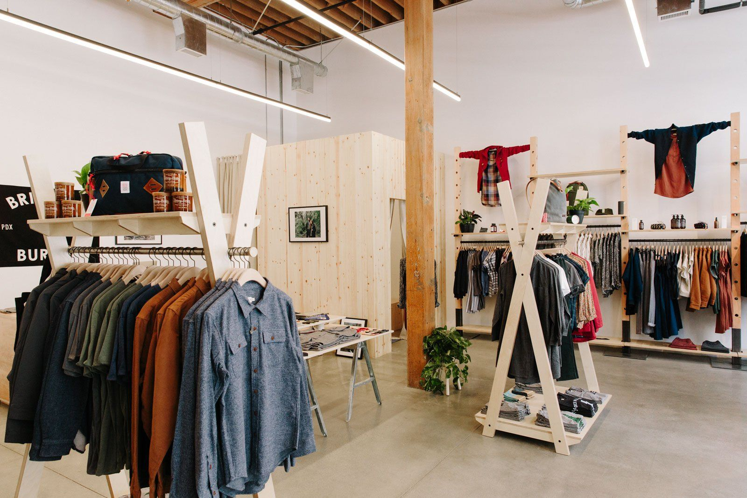
Who we are - PHENS of the Community since 2014
Established in Santa Monica, California in 2014
7.2 Million Dollars of Annual Recurring Revenue
We sell every day and business casual wear for both men and women, targeted towards middle-age adults in their early 30’s through early 40’s.

Slide 3
Our Data set
Variables & Description
1) Unique ID number for each ad
2) Campaign ID number for PHEN’s tracking purposes
3) Campaign ID number for Facebook’s tracking purposes
4) Age
5) Gender
6) Impressions: the number of times the ad was shown
7) Clicks- number of clicks on that ad
8) Spend- amount paid by us to Facebook to show the ad
9) Total Conversion- total number of people who enquired about our products after seeing the ad
10) Approved Conversion- total number of people who bought our product after seeing the ad
Data from multiple facebook ads and their associated variables
Added additional feature columns:
Cost Per click
Click through Rate
Clicks Per conversion
Cost Per Impression
Grouped the data by gender and the calculated the added feature columns

Slide 4



Our Business Case
Looking to launch a new line (athleisure)
Optimize our marketing budget subject to conversions
Estimating $600,000 in revenue during the launch month
3% is dedicated to advertising on social media
Roughly $18,000
Decision variables: the number of impressions for women, number of impressions for men, and the cost
Looking for 900 total conversions (500 men and 400 women)

Slide 5

Purpose
Launch of a fun, comfortable, and exciting new athleisure line.
Attract new and existing customers to our website
Increase traffic of customers online and in-store
New marketing approach will route new and existing customers to our website to purchase
We want to minimize our costs most effectively while acquiring our target number of customers
Notes:
The upper management team and employees of PHENS & CO believe that our growth and success in the casual wear and business casual markets can be applied just as successfully through the launch of a fun, comfortable, and exciting new athleisure clothing line. We will be offering a variety of items including but not limited to tank tops, sports tees, sweatshirts, running shorts, leggings, sweatpants, joggers, and tracksuits, in a variety of colors, sizes and styles. These items can easily substitute jeans and a t-shirt when you’re on the go, working out or just enjoying some down time. More importantly, we are hoping that this new launch will attract new and existing customers to our website, and increase traffic of customers online and in-store.
Our main marketing approach with this upcoming athleisure launch will be to create new and exciting marketing material through Facebook ads, in hopes that we can route new and existing shoppers and customers to our website to purchase from us.

Slide 6
Analyzing Previous years Campaign Data
Target Gender | Cost per Impression | Cost Per click | Clicks per Conversion | Click-Through Rate
Women | $0.00029 | $1.46 | 48.58 | 1.91%
Men | $0.0022 | $1.64 | 25.76 | 1.91%
On average we have a 1.91% click-through-rate
On average we see 48.58 clicks per conversion for women and 25.76 clicks per conversion for men
Notes:
The first thing the PHENS & Co. marketing team did was average all of our columns and group them by gender. For females we came up with a $1.46 cost per click, 48.58 clicks per conversion, and a $0.00029 cost per impression. For men we got a $1.64 cost per click, 25.76 clicks per conversion and $0.00022 cost per impression. After some initial struggles and some unrealistic data for the click through rates, we did some research and found that a $1.91 click through rate is the average cost in retail advertising, and decided to use that value for our analysis. If we end up with a higher or lower click through rate after this campaign is complete, we can easily adjust our numbers for any future marketing campaigns.

Slide 7
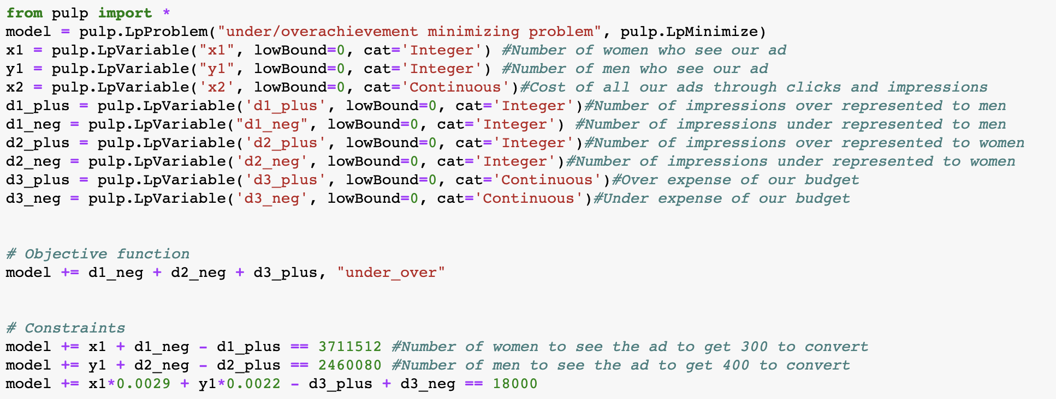
Implementation #1
Pulp Library
Underachievement/overachievement problem
Notes:
Our x1 variable is the number of women who see our ad and it is categorized as an integer. Our y1 variable is the number of men who see our ad and that is categorized as an integer as well. Our x2 variable is the cost of all our ads through clicks and impressions which we categorized as continuous. Our d1 plus variable is the number of impressions over represented to men while our d1 neg is the number of impressions under represented to men. The d2 plus variable is the number of impressions over represented to women while our d2 neg is the number of impressions under represented to women. The d3 plus is the over expense of our budget with the d3 neg representing the under expense of our budget of $18,000.

Slide 8

Optimization Results..
Discovered that in order to achieve 900 conversions, we would need 3,711,512 impressions for women and 2,460,080 for men
In order to achieve 500 conversions for men and 400 for women we would spend $16,175.56 - coming in $1,824.44 dollars under budget

Slide 9


Implementation #2
Purpose-- Minimizing our cost of production subject to these constraints:
Total conversion per advertisement
Conversion costs
Converted shoppers

Slide 10
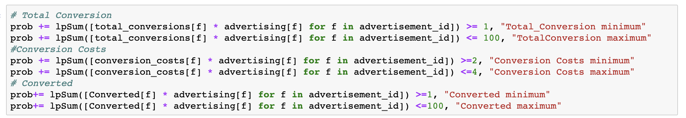
Implementation #2
Purpose-- Minimizing our cost of production
Notes:
The main objective function is to minimize the spent per advertisement subject to constraints like total conversion per advertisement should be greater than 1 and less than 100. Spent per clicks or cost per conversion(conversion_costs) should be greater than 2 and less than 4. Approved conversion(converted)should be greater than 1 and less than 100.

Slide 11


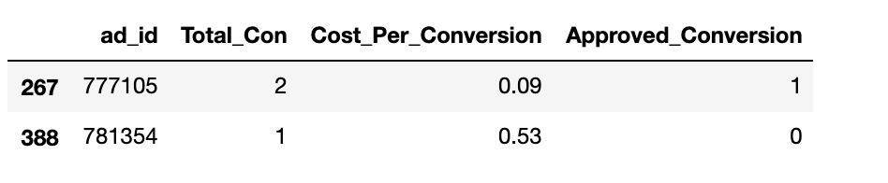
Optimization #2 Results...
Advertisement Id #’s 777105 and 781354 abide by the constraints we imposed.
We need $2 to acquire 1 customer
Notes:
After optimizing we found out that these are the advertisement ids that can yield us 1 customer for $2.

Slide 12

conclusion
The number of impressions required for our desired conversions seems high, but this is backed by our metrics from previous campaigns.
On paper, this should meet our goals, but too many unknown variables may influence our results.
We will use the analysis and new information from our findings to implement into our next campaign.

Slide 13

Questions?

